Slide 1

DESIGN AND CONSTRUCTION OF AN INTELLIGENT TOLL PAYMENT SYSTEM USING GSM PHONE NUMBER AIRTIME AND DATA
BY
ADEUYI ANJOLAOLUWA J.
140403034
SUPERVISED BY DR. F.L OGBOI

Slide 2
OUTLINE
Introduction
System Overview
Components of the ETC System
Project Flowchart
Design Consideration
Design Layout
Design PCB Models
The Complete System
Simulated Results
Design Features
Conclusion
Recommendation

Slide 3
INTRODUCTION
An intelligent Toll Payment system is a unique and mature model for electronic toll collection (ETC) system that allows electronic payment of tolls between vehicle owners and toll agency at highway speeds without interrupting the traffic flow.
An intelligent toll payment is a system that has been designed both for convenience and for financial derivation or benefits.
The device utilizes the Radio Frequency Identification (RFID) technology which helps to automatically detect the identities of the vehicles approaching the tollgate and deduct the toll charges as pre-configured in database of the microcontroller using the GSM Module embedded into the system.
The design uses a GSM Module aided with a UART communication protocol for transaction and communication processes with the 3rd party agency.

Slide 4
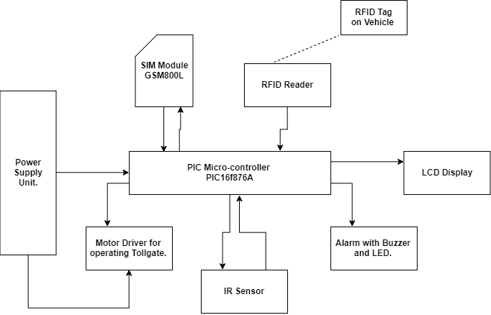
Systems Overview
.

Slide 5
COMPONENTS OF THE ETC SYSTEM
Automatic Vehicle Identification (AVI)
Automatic Vehicle Classification (AVC)
Methods of System Registration for New Users.
Transaction Processing.

Slide 6
Automatic Vehicle Identification (AVI)
AVI Systems has two components:
On board Unit or Transponder mounted on vehicle (RFID Tags)
Road-side antennae (Interrogator) mounted on a gantry at the toll station (RFID Reader)

Slide 7
Automatic Vehicle Classification (AVC)
AVC Systems has two classification according to the proposed design specification:
Registered or VALID_Users
NON VALID User or New_User

Slide 8
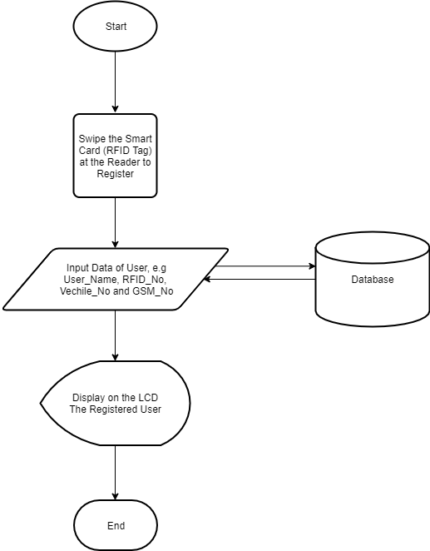
Methods of System Registration for new Users
New Users Registration can be done with two main methods unlike the existing ETC Systems available.
Registration at toll station.

Slide 9
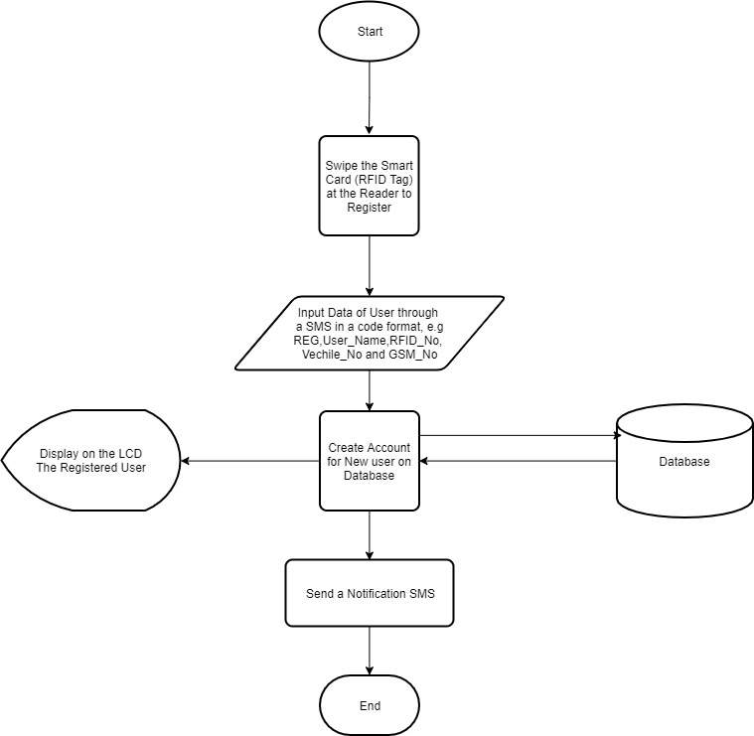
Methods of System Registration for new Users
New Users Registration can be done with two main methods unlike the existing ETC Systems available.
Registration at any remote location via SMS UART Protocols.
REG,User_Name,RFID_No,Vehicle_No,GSM_No

Slide 10
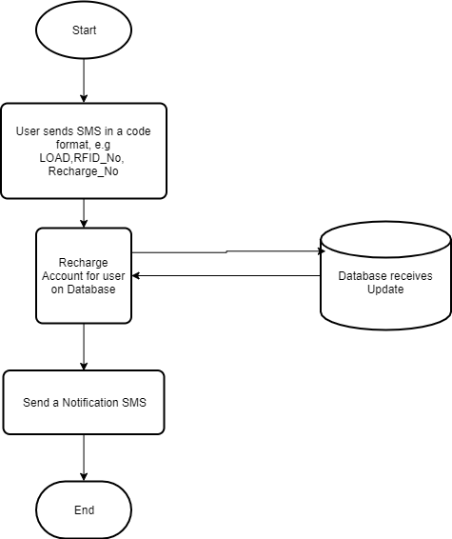
Transaction Processing
Process of debiting customers’ accounts and answering customer inquiries.
LOAD,RFID_No,Recahrge_No

Slide 11
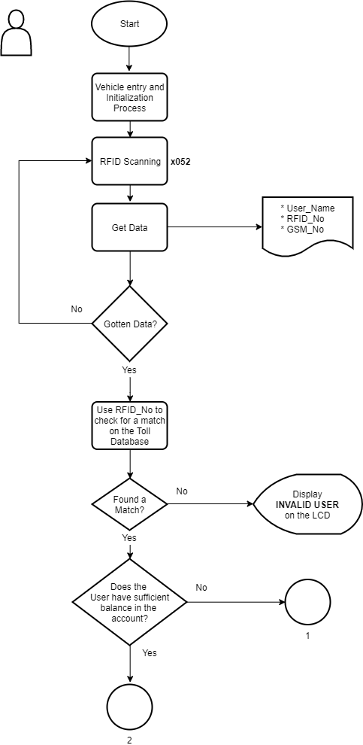
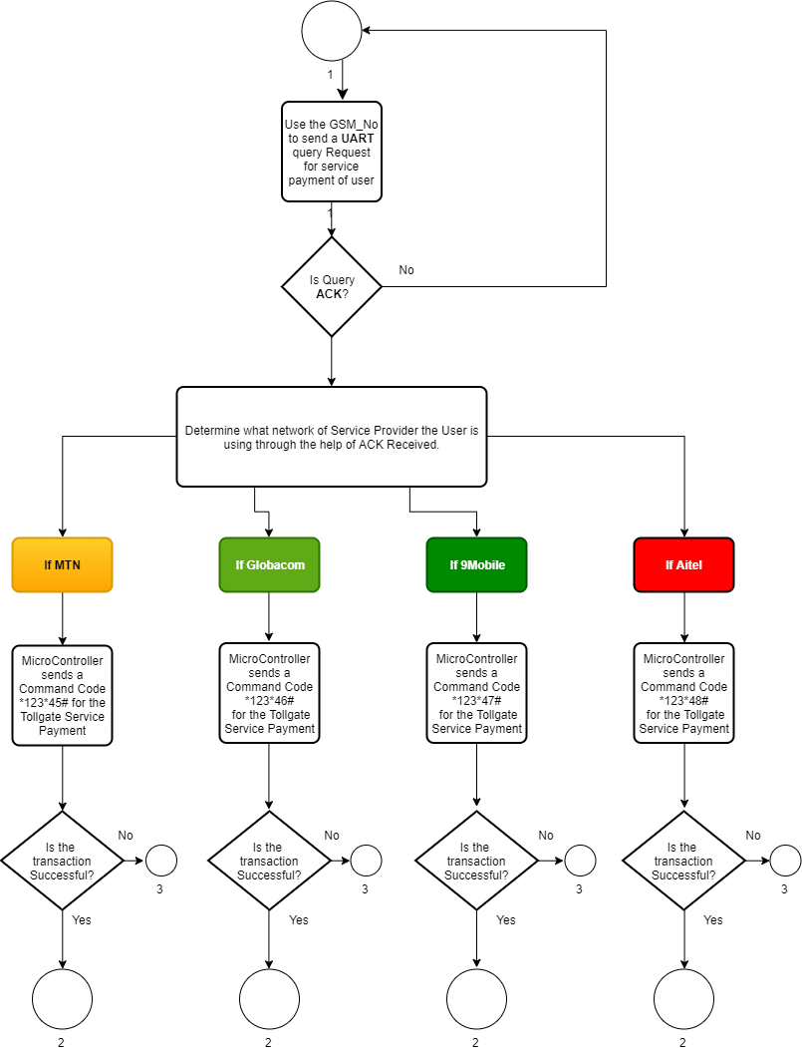
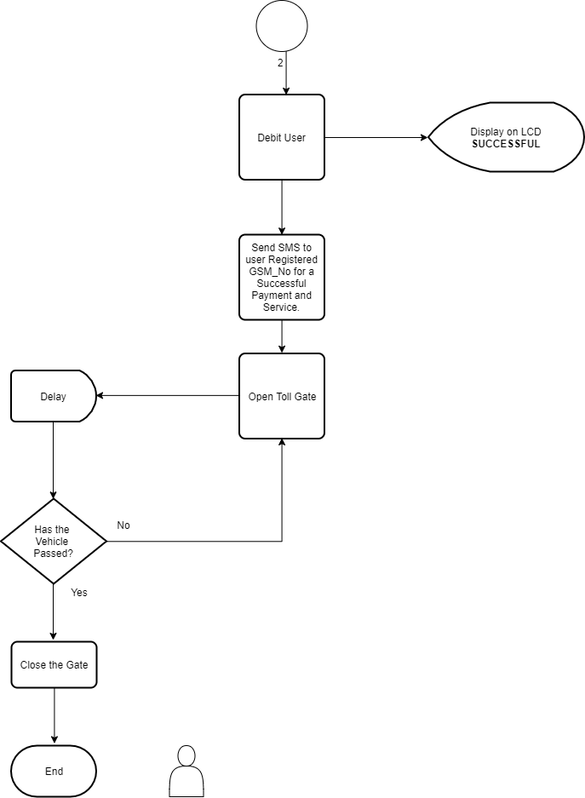
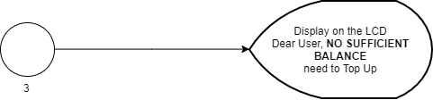
System Flowchart

Slide 12
DESIGN CONSIDERATIONS
Size and Portability of Circuit:
Type of Microcontroller, memory and Components to use.
Programming language to use.
Cost of the Project components.
GSM and UART communication Protocol Utilization.
Radio Frequency Power and Frequency Selection.
Duration.

Slide 13
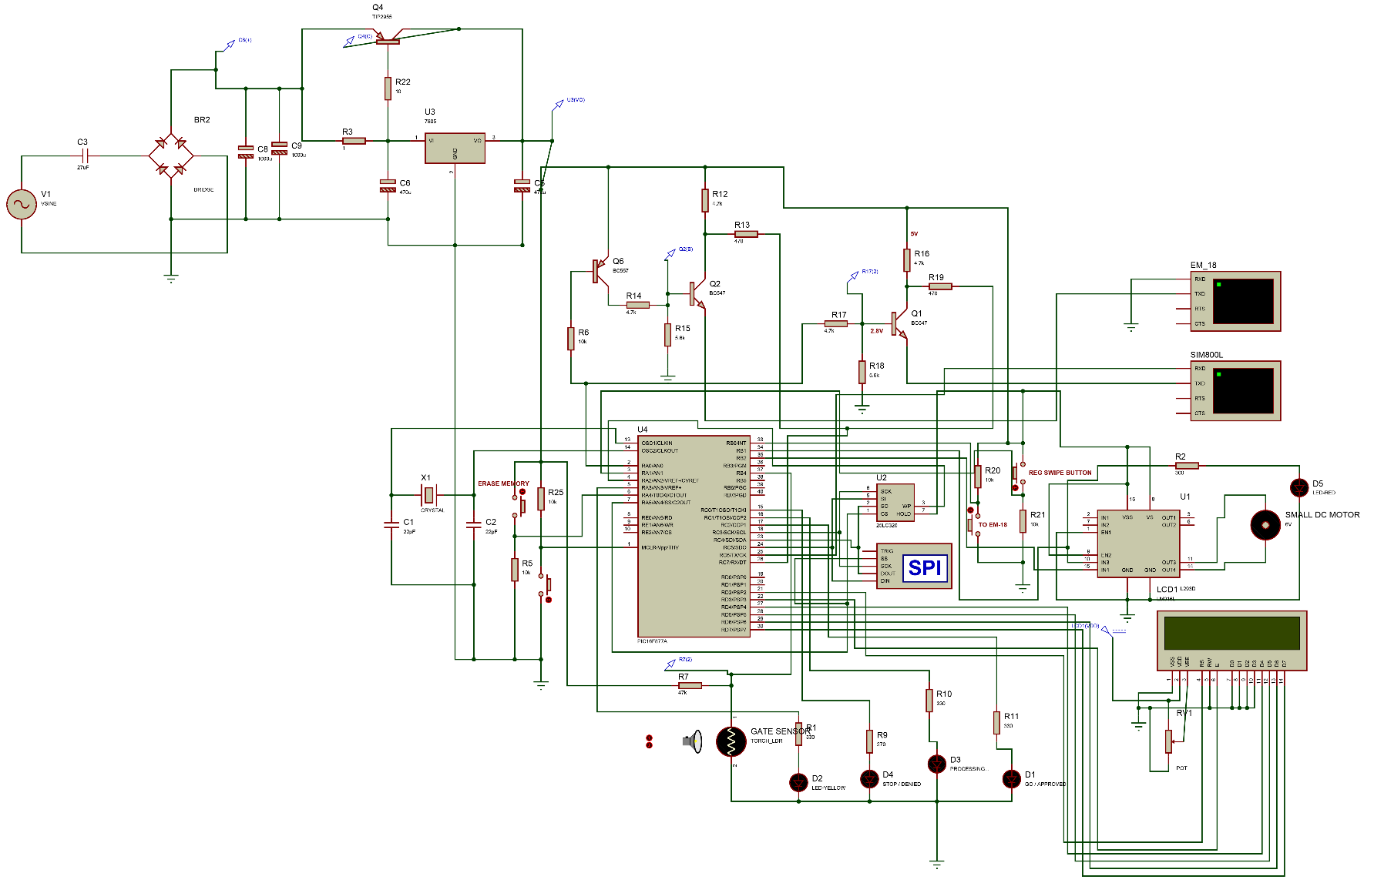
DESIGN LAYOUT
Schematic diagram

Slide 14
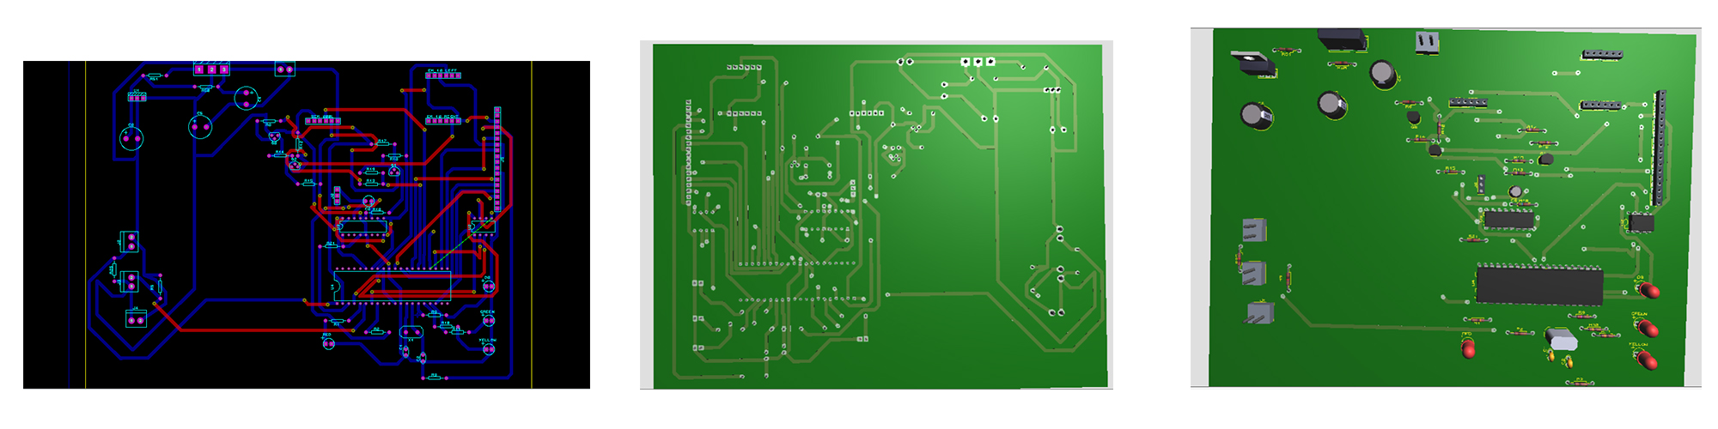
DESIGN PCB Models.
.

Slide 15
The Complete System

Slide 16
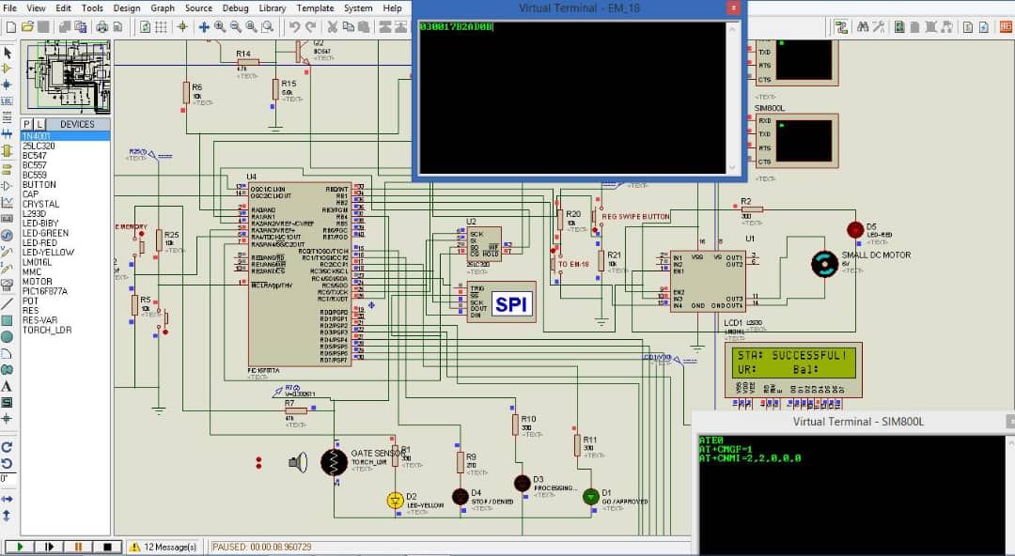
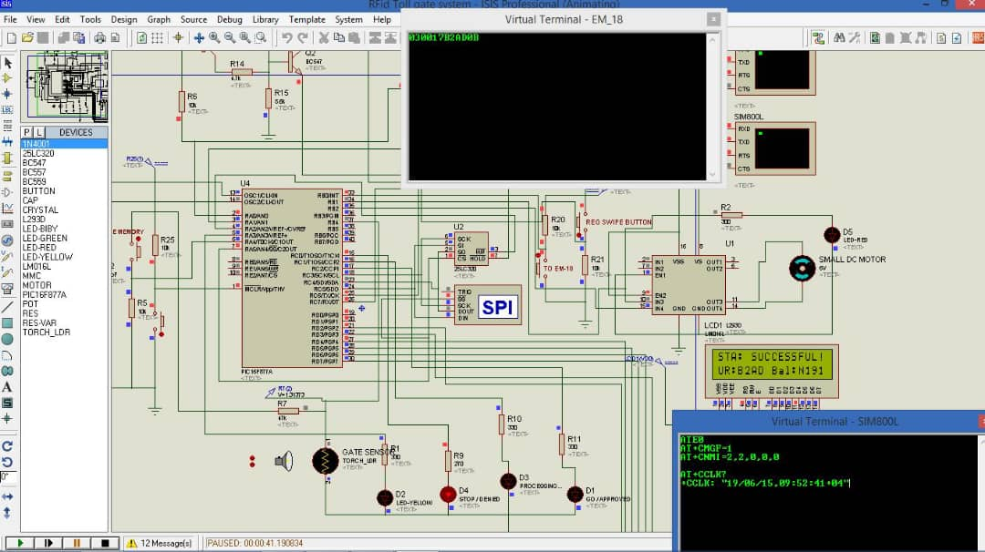
Simulated Results

Slide 17
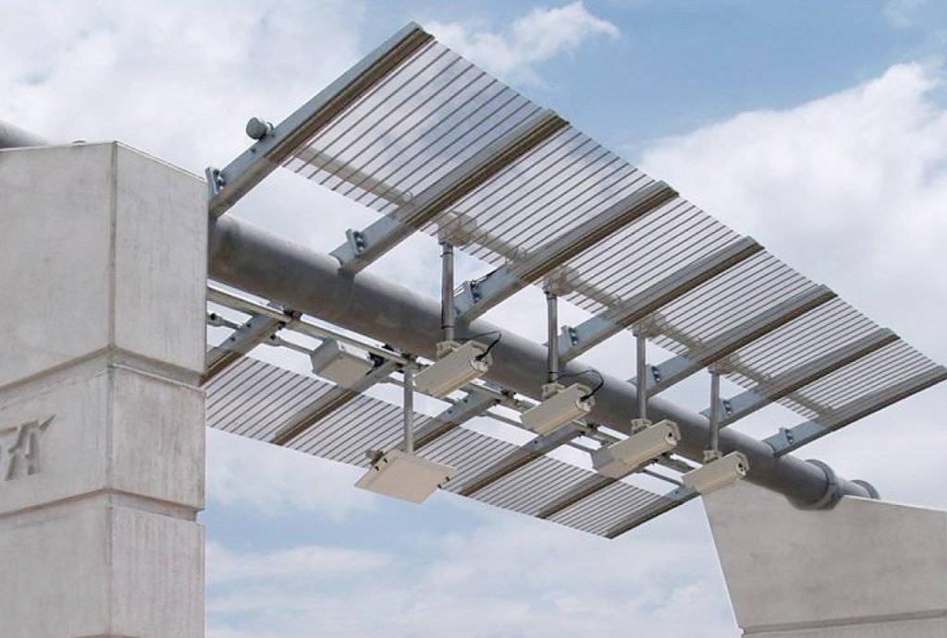
DESIGN FEATURES
Flexible Entry logging or Registration.
De-Centralizing database of Users i.e.
All First User of the Toll service will be given a one time free time and from time to time a promo code.

Slide 18
CONCLUSION
By introducing the concept of GSM Phone number and Airtime in the design of an intelligent Toll Payment Collection System (ETC) we can make Toll Services more efficient and faster than the existing system.
The system provides more flexibility and convenience for the user (Vehicle owner/Driver).
Around 85-90% of the benefits comes from travel time-savings for commuters.
Since most of operational portion of the project is software based hence the hardware cost is saved and system failure is minimal.

Slide 19
RECOMMENDATION
Interoperability of various ETC Systems across the country in order to make the model more intelligent and reliable.
A machine learning algorithm to understand the user through the data inputs provided.
Integration of this new technology with all GSM phone number service provider for a large scale design implementation and deployment
A Big Data Center should be implemented for keeping track of all Toll User data's
User should be shown real-time details of their trip and transactions through the implementation of mobile applications such as internet of things(ioT)
A better facility for both Prepaid and Postpaid paying method can be implemented.

Slide 20
THANK YOU

